Slide 1








INTRODUCTION TO THE
BLOCK PREPAREDNESS COORDINATOR PROGRAM
Ken Dueker, J.D.
Director
Emergency Services
Annette Glanckopf
Chair, PAN EPREP Committee

Slide 2
Housekeeping
Sign In
Cell Phone
Side Conversations
Questions
Restrooms
ICE

Slide 3
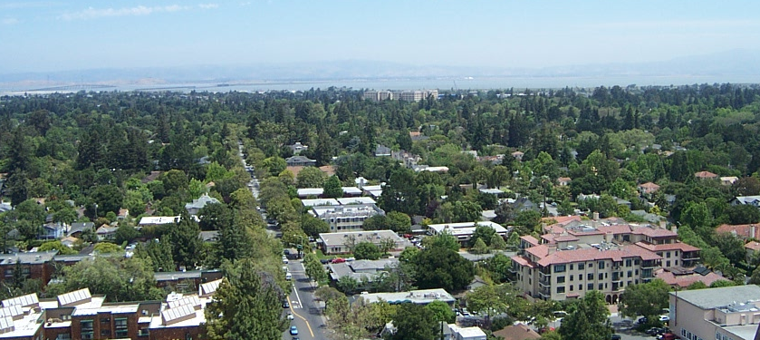
The Palo Alto Problem
The daytime population in Palo Alto is well over 70,000. Add another 35,000 for normal Stanford campus population, and there can be up to an additional 100,000 during Stanford Football and holiday shopping season.
There are 61,200 PA residents in 27,000 single and multi-family dwellings in 30 neighborhoods over 26 square miles
There are roughly 6,000 business with 100,000+ employees. Some are (should be) disaster resources.
How many Police Officers are on duty now?

Slide 4


City Response Staffing
There are only 24 firefighters on duty on any given day.
(It takes approximately 15 -20 firefighters to respond safely
to one full-structure incident.)
There could be as few as eight police officers on patrol duty.
      Daily Calls (911) for Incidents:
      Police Dept. - 170
      Fire Dept. - 20 (primarily EMS medical)
There are 40 Utilities operational personnel for Electrical Operations and 30 in Water, Gas, and Wastewater.
There are 40 Public Works operational personnel

Slide 5
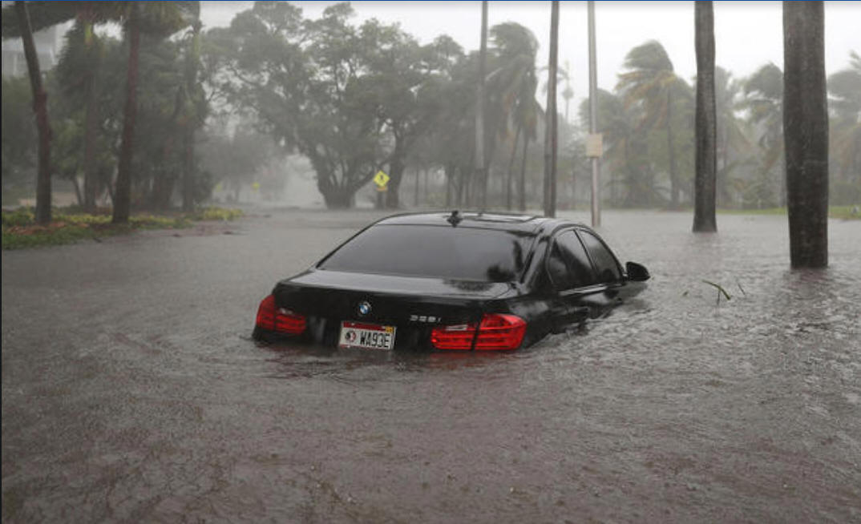
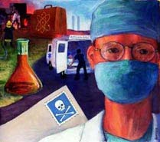
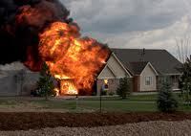
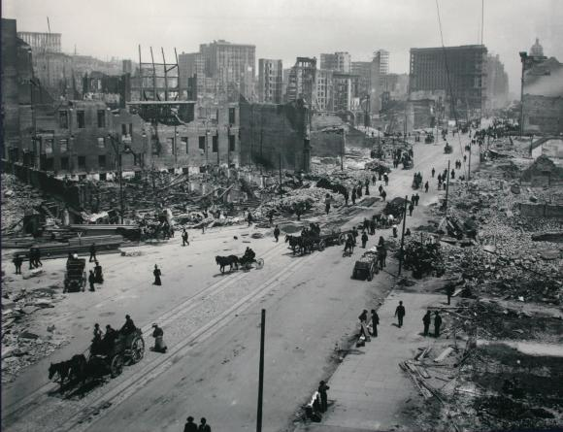
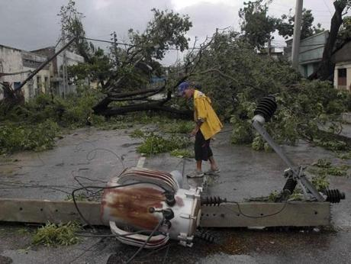

Slide 6
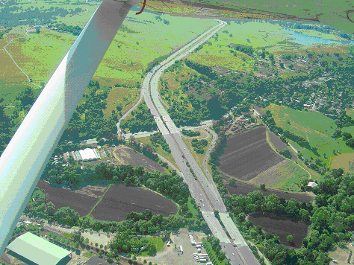
Core Goals
Residents and businesses (etc.) are resources, not victims.
PEOPLE, not plans in a binder, are the key to response and recovery. We must have COMMUNICATIONS to achieve.
The community can provide information to the City:
Initial Damage Estimate
Transportation Status
Incident Reporting
Resource Sharing
“Eyes and Ears” Function

Slide 7
THE BPC PROGRAM
DEFINED

Slide 8
Block Preparedness Coordinator
Program
Partnership between Community and City
Establishes communications links to “blocks” (residences & businesses)
Promotes resilient community/self-sufficiency
Ties non-governmental entities to the Incident Command System (ICS).
Motto: “Changing the role of community members from victims to partners in disaster recovery.”

Slide 9

BLOCK PREPAREDNESS COORDINATOR
Crime
Emergency
Disaster
Information Sharing
Social

Slide 10
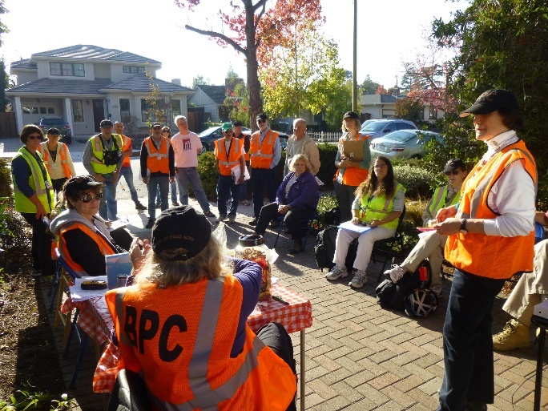
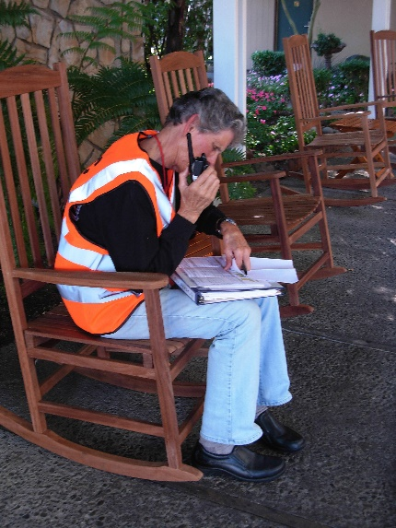
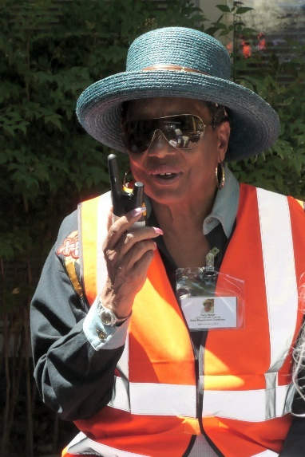
What is a
Block Preparedness Coordinator ?
Eyes and ears for the block
  Social
  Sharing information
  Crime watch
  Communicator in a disaster
Responsible for 10-35 residences
or businesses
Stay on block in an emergency or disaster
Three hours of training, with periodic training and drills

Slide 11
KEY BPC ACTIVITIES
Complete the ESV application
Meet your neighbors
Create a neighborhood list (directory) and provide each neighbor with the list
Create a phone tree for communications
Recruit a runner/biker for information/supplies
Distribute OK/HELP signs to each neighbor
Purchase an FRS radio and recruit a co-BPC
Prepare an Emergency Response Grab-Go Bag
Install a lawn sign
Participate in an emergency/disaster drill
Plan an event once a year

Slide 12
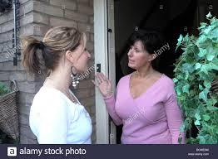
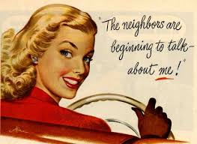
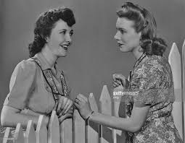
MEET YOUR NEIGHBORS
Make individual contact with each household
Distribute information
Collect contact information

Slide 13
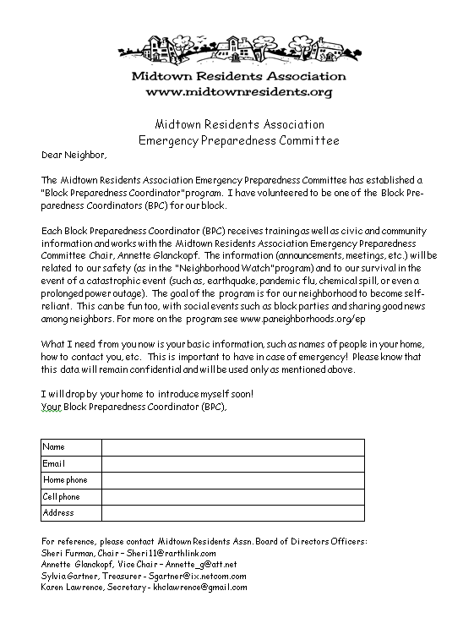

Slide 14
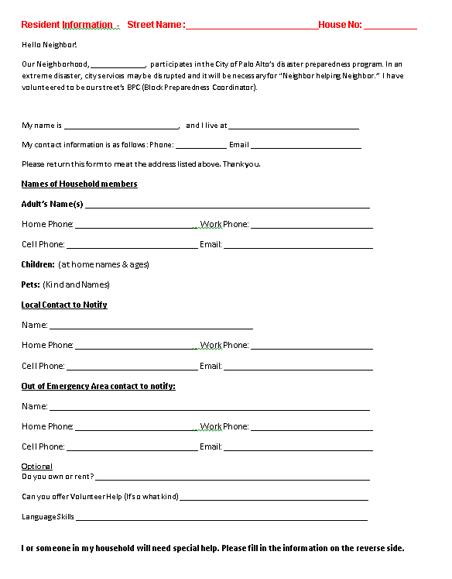

Slide 15
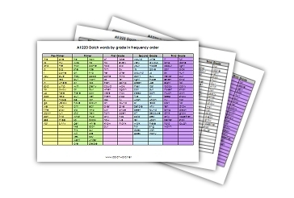
DEVELOP
YOUR BLOCK LISTS

Slide 16

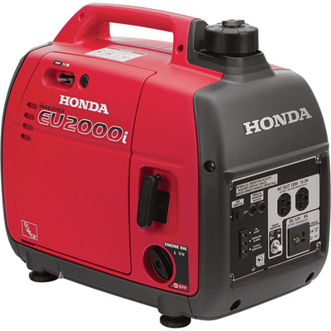
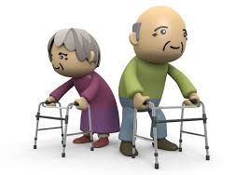
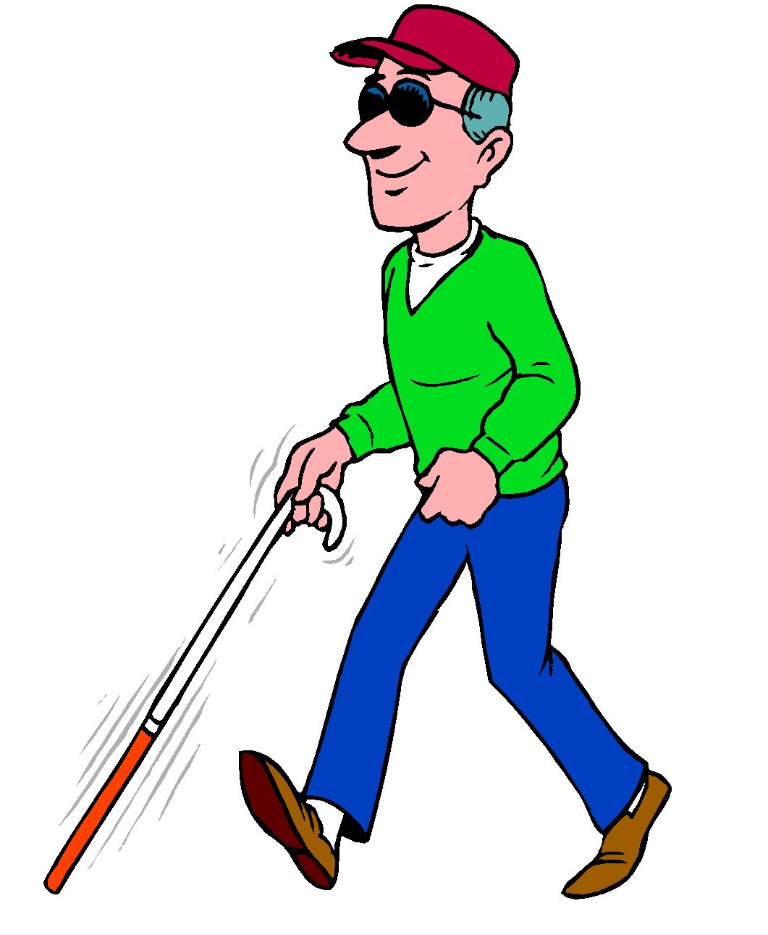
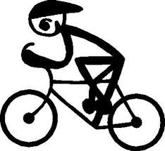
KNOW WHERE
Block resources (nurses, dentists, vets, retired fire/police/military)
Where are supplies - shovels, tools, generator, medical supplies, bikes, etc.
Which neighbors will need extra help (mobility impaired, blind, etc.)?
Where are bikers – recruit runner/biker?

Slide 17

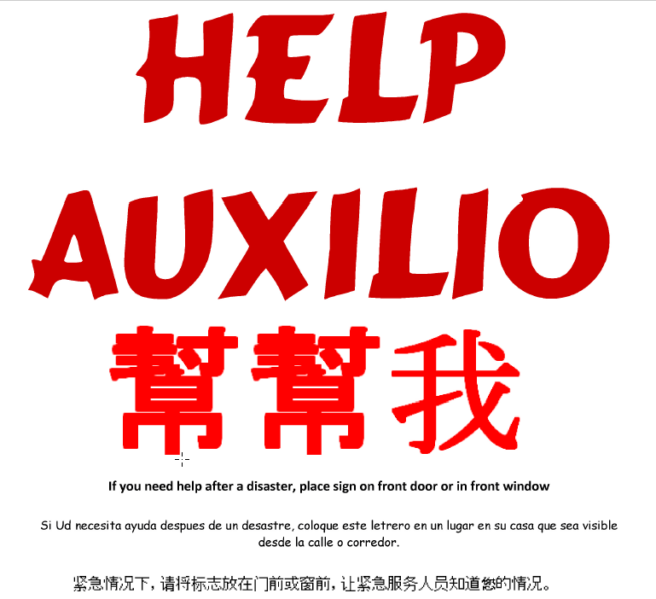
DELIVER HELP/OK SIGNS

Slide 18
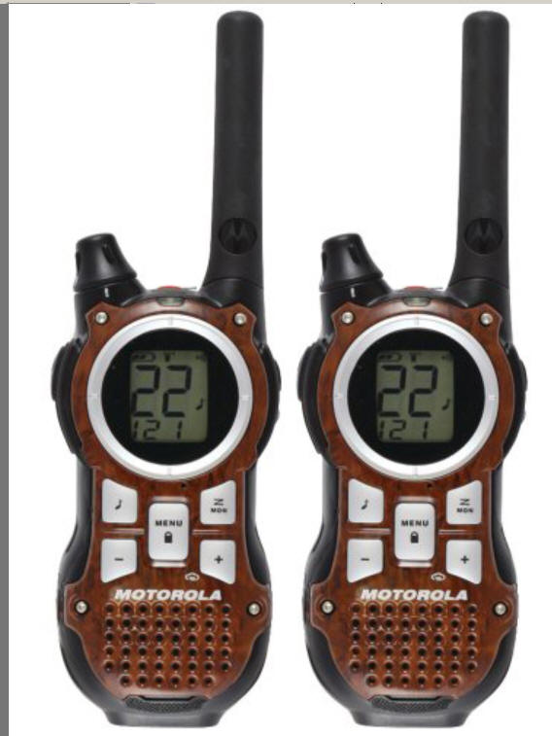
PURCHASE AN FRS RADIO

Slide 19
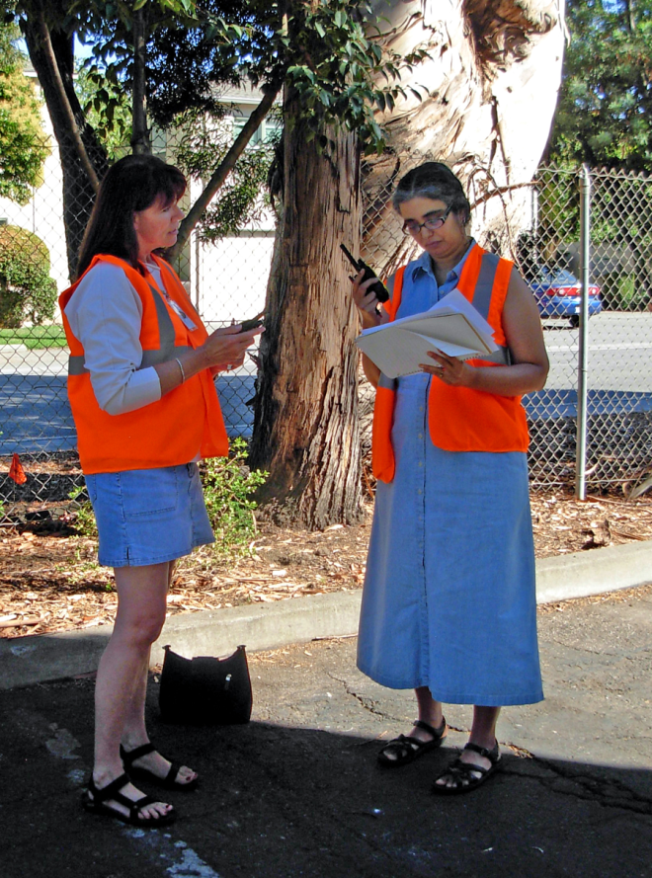
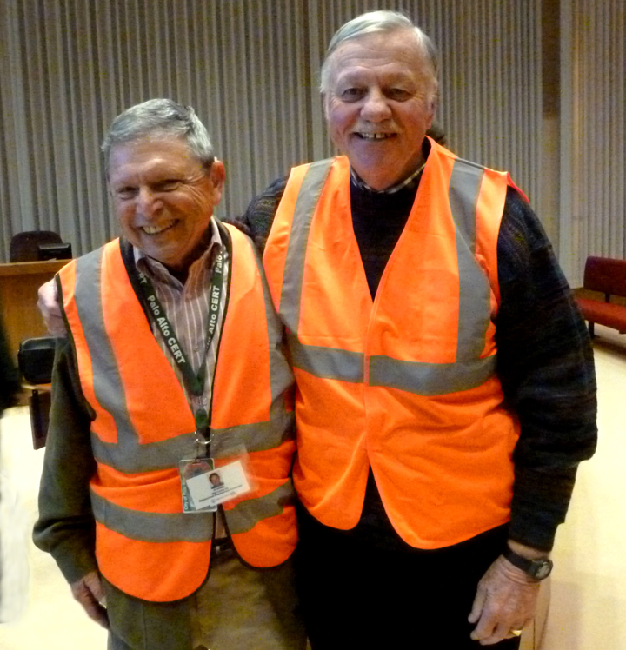
RECRUIT A CO-BPC

Slide 20
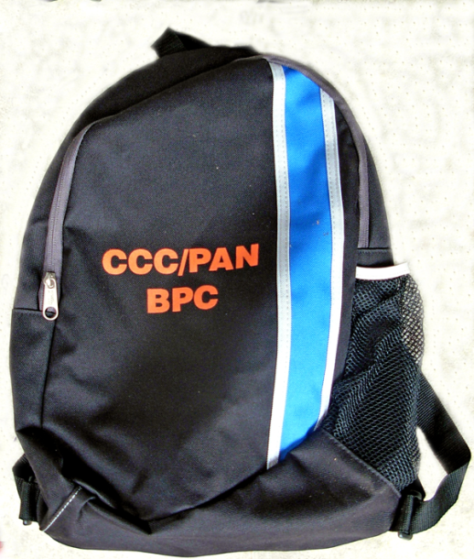
BUILD YOUR
EMERGENCY RESPONSE BAG
Recommended Items
  VEST/cap/ID badge
  FRS/GMRS radio + additional batteries
  Flashlight (1-2)
  Clipboard with blank paper for notes & waterproof pen(s)
  Block maps and a location map of your NPC & closest NPCs .
  Hardcopy neighborhood list of names and contact information
  Additional contacts
  Radio instruction sheet/NATO alphabet
  Blank (or filled out) DA forms
  First aid kit (small)
  Tissue pack
  Whistle on lanyard
  Water (bottle), snacks
  Other: duct tape, gloves

Slide 21
INSTALL A LAWN SIGN

Slide 22
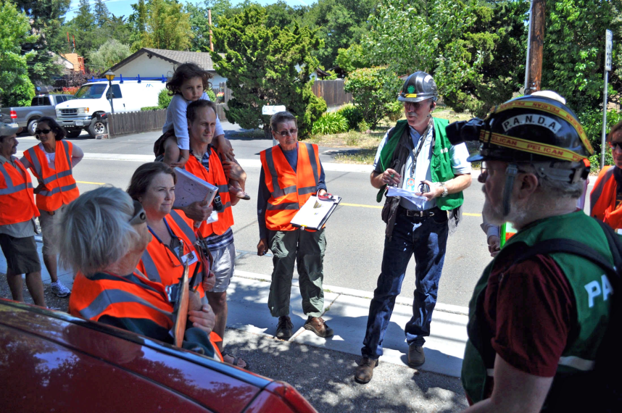
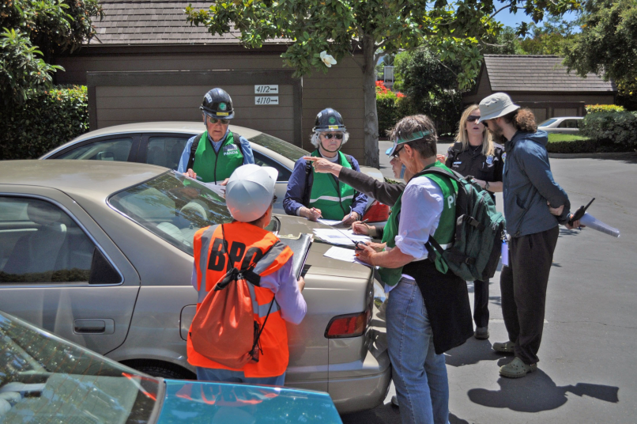

PARTICIPATE IN A (RADIO) DRILL

Slide 23
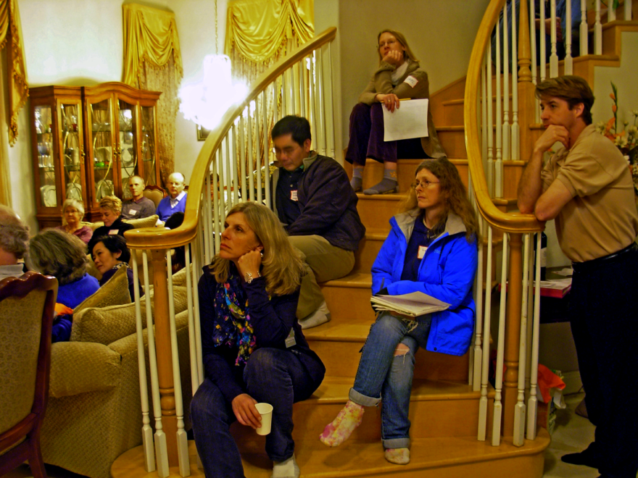
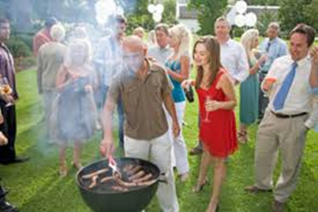
WHAT TYPE OF ANNUAL EVENT
WILL YOU HOST ?
Crime Prevention
Soup Night
Block Party
Personal Preparedness
What other themes can
you think of?

Slide 24
SEND PERIODIC MESSAGES
Welcome new neighbors
“We are having a Block Party,” etc.
Messages from the OES (Office of Emergency Services), City of Palo Alto, your neighborhood
E-prep tips
Thanksgiving or Daylight Savings Time
  Check on supplies and replace if outdated:
      Batteries
      Food
      Water

Slide 25
BPC ANNUAL REQUIREMENTS
Participate in quarterly neighborhood radio check-ins
One class or event
One drill
Annual recognition/kickoff meeting

Slide 26
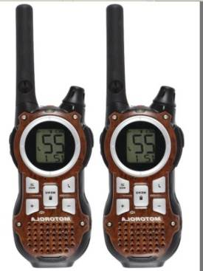
BPC ROLE
IN A DISASTER
BPCs provide information
(incidents and damage)
to the neighborhood
via FRS radio
Initial Damage Estimate
Transportation Status
Incident Reporting
Resource Sharing
“Eyes and Ears” Function
26

Slide 27
Neighborhood Preparedness Coordinator Key Activities
Coordinate emergency/disaster preparation for the neighborhood
Neighborhood Association Committee Representative
Serve as a communication node for your neighborhood
Point of contact during a disaster
Coordinate BPCs, deploy neighborhood CERT members, and conduct disaster communications

Slide 28
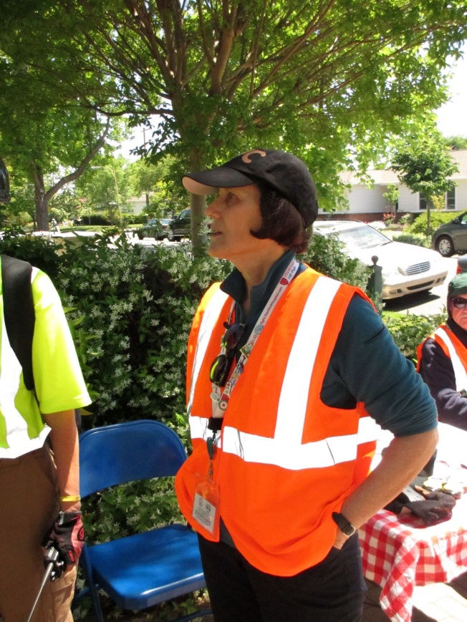
MEET YOUR NPC
Introductions
Get ID, vest, cap
Get BPC number
Identify your “block”
Verify communication
channels
Etc…

Slide 29
BPC & NPC Training
Core Modules
Total 3 hours for BPC Certification training
  Background, role of Emergency Services Volunteers
  Communications - Radio I01
  Damage Assessment
NPC Training, in addition to BPC Certification training:
  Installation of MURS radio
  Radio 102
  ICS online courses
Other optional training
  Radio 102
  Crime Safety
  First Aid/CPR

Slide 30
OES WEB SITE
“GET INVOLVED”
Descriptions, SOP, Class Calendar, Maps
http://www.cityofpaloalto.org/services/public_safety/get_involved/default.asp
http: www.cityofpaloalto.org/emergencyvolunteers

Slide 31
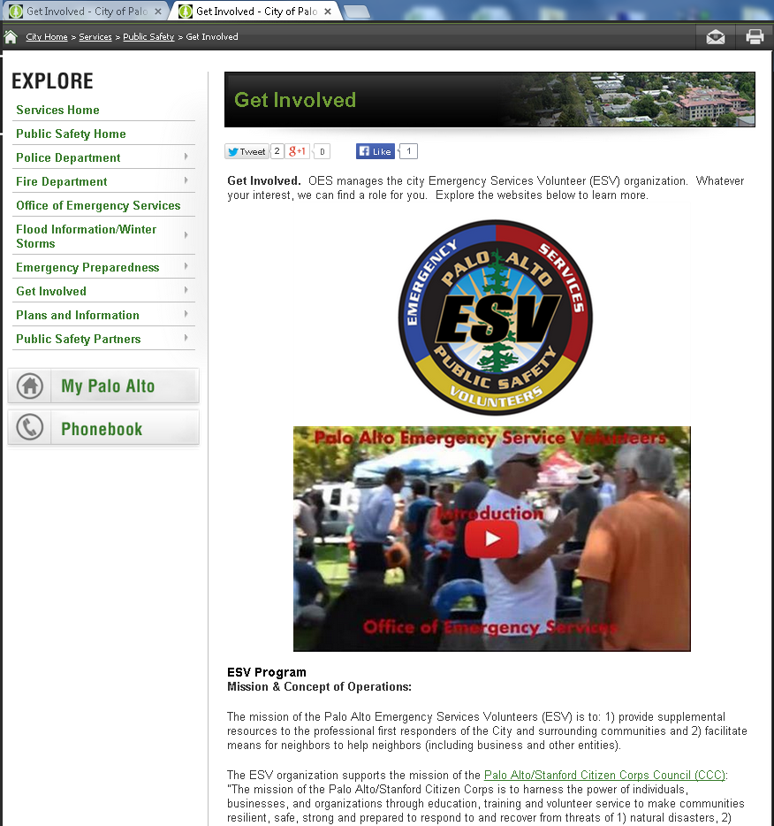
Scroll
Down

Slide 32
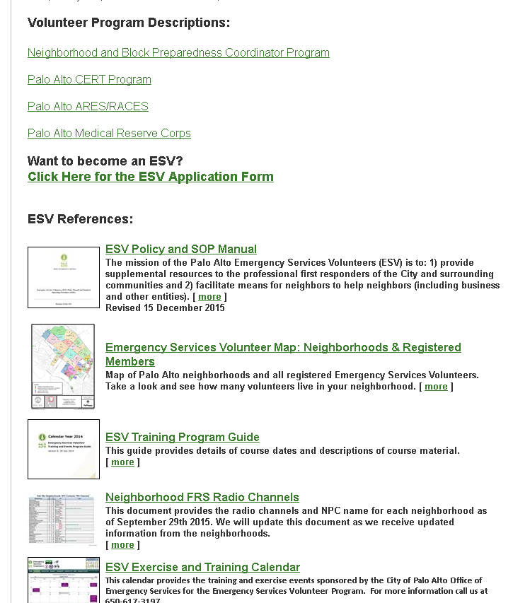

Slide 33
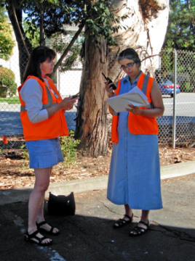
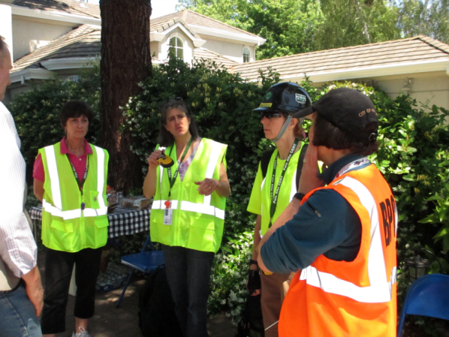
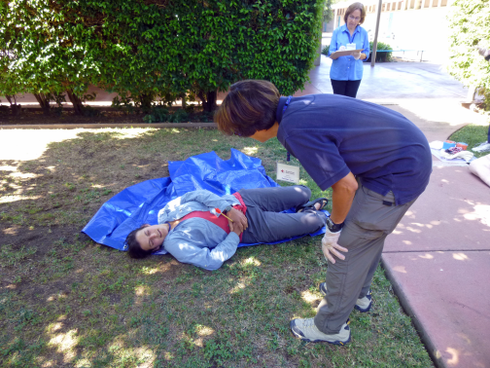
TYPES OF ESVs
(EMERGENCY SERVICES VOLUNTEERS)
BPC (Block Preparedness Coordinator)
NPC (Neighborhood Preparedness Coordinator)
CERT (Community Emergency Response Team)
Ham Radio Operators
MRC (Medical Reserve Corps)

Slide 34
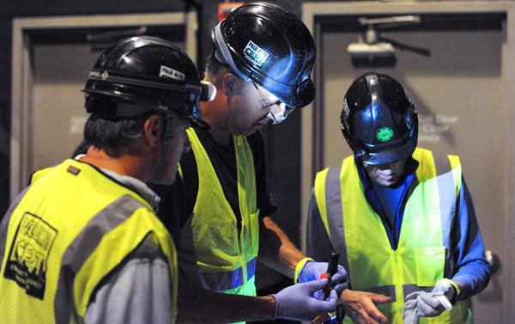
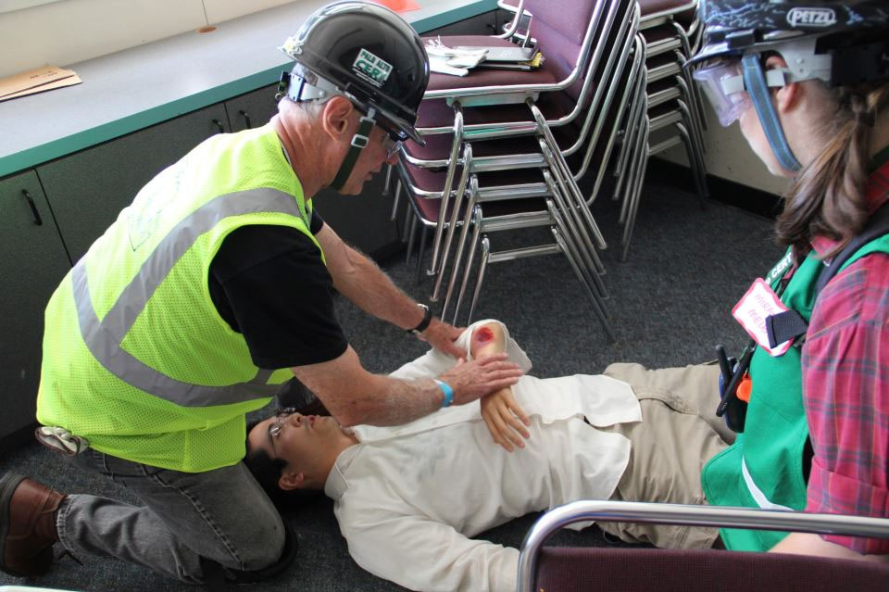
What Is a CERT ?
Community Emergency Response Team
Trained in the following:
  Light search-and-rescue
  Light fire suppression
  Triage
Deployed within neighborhoods (or citywide if neighborhoods are safe)
24 hours of training with periodic updates

Slide 35
Compare BPC and CERT
Palo Alto CERT members:
  Palo Alto’s Community Emergency Response Team (CERT)
  CERT members are OES volunteers
  24 hours of training in light search-and-rescue, etc.
  Neighborhood CERTs & Citywide CERTs
Block Preparedness Coordinators (BPCs):
  Community volunteers
  Receive 3-4 hours of training from PAN and Police Department
  Stay in their neighborhoods on their block

Slide 36
Communications Links
Palo Alto City
(Mobile) Emergency Operations Center ((M)EOC)
ESV DOC (if not established, NPCs, etc. go direct to EOC)
Ham Radio
CERT Field Teams
MURS Radio
Neighborhood Preparedness Coordinator
FRS/GMRS Radio
FRS/GMRS Radio
Block Preparedness Coordinators
Neighborhood CERTs

Slide 37
Why Become a Emergency Services Volunteer ?
Knowing you are ready and will be better able to help yourself, your family, your block, your neighborhood, and community in an emergency
Teamwork and skills development
In an emergency you will be "in the loop” and “connected” as opposed to in the dark…
Other benefits:
  Radio skills! Useful in peacetime as well as emergency!
  New and refresher emergency skills training courses!
  Regular and annual emergency preparedness drills and coaching
  Fun!

Slide 38
GOAL
Role for anyone who wants to participate
Identify points of support in the community
Train sooner rather than later

Slide 39
IN CONCLUSION
The BPC Program is about neighborhood awareness and readiness, and neighbors helping neighbors; more importantly, your safety as a BPC and doing the greatest good for the greatest number.
On behalf of the PAN E-Prep Committee, we want to express our sincere gratitude for your support and contribution to our neighborhood.
You are the neighbors who are helping neighbors.

Slide 40
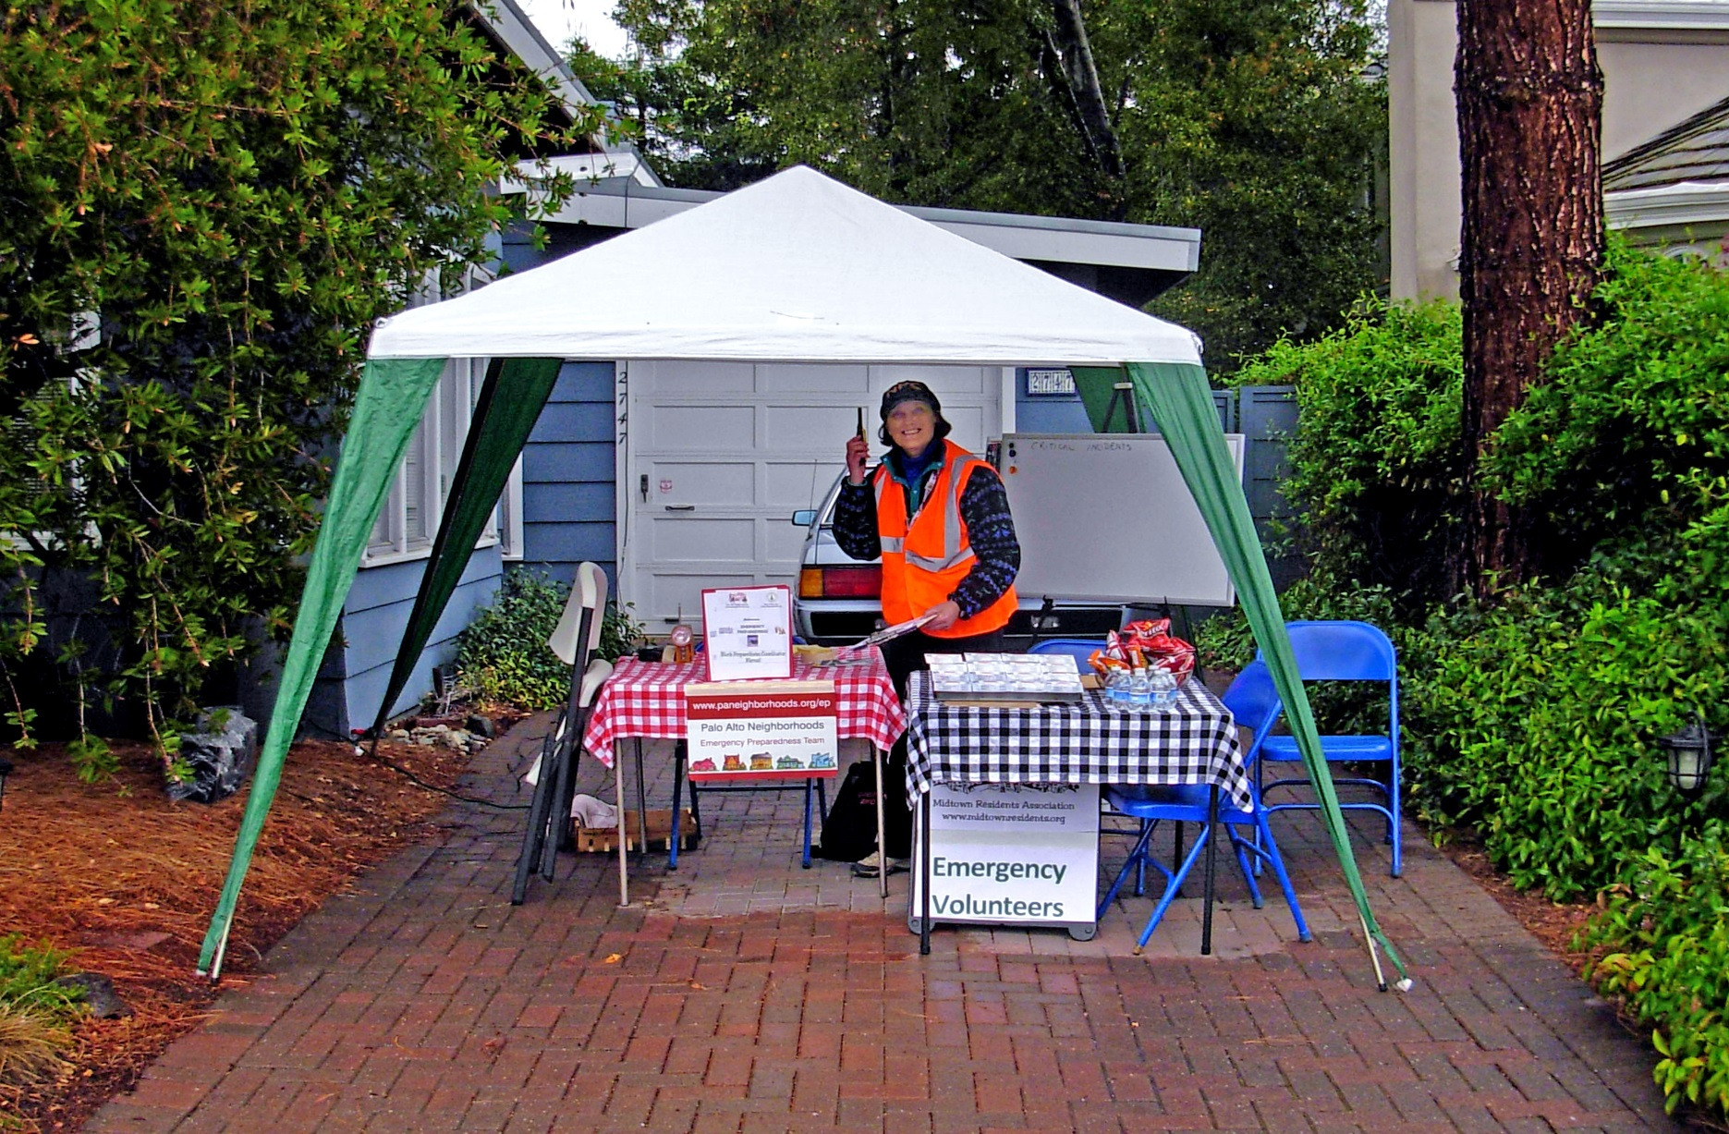
Join us, don’t be on your own

